Slide 1
Coronary Heart Disease
Conrad Frisch, Lai Pham, Johnny Chapman

Slide 2



Objective: Predicting if At Risk of Heart Disease
Notes:
Conrad

Slide 3

Data
Size of the data set: 3656
Variables: 21
49% are smokers
11% are heavy smokers
54% Overweight
Source: https://www.kaggle.com/dileep070/heart-disease-prediction-using-logistic-regression#framingham.csv
Notes:
Conrad
Heavy smoker more than 9

Slide 4

Real World Statistics
17% of Americans smoke cigarettes (CDC)
8% consume some type of vape product (Gallup)
70% of Americans are considered overweight (NHANES)
Notes:
Johnny
Compare our data to real world statistics
Slightly more smokers
Less overweight people

Slide 5

Cost of Heart Disease
US: $200 billion per year
Average out-of-pocket: $2,450
Notes:
Conrad
Insurance

Slide 6
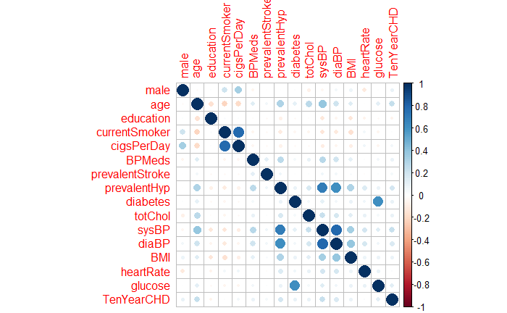
Correlation Matrix
Highest Correlation with CHD:
Age
Blood Pressure
Notes:
Lai

Slide 7
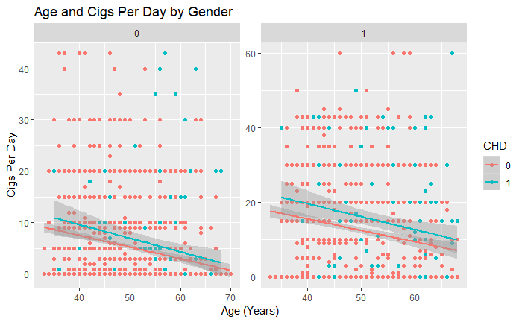
Female Male

Slide 8
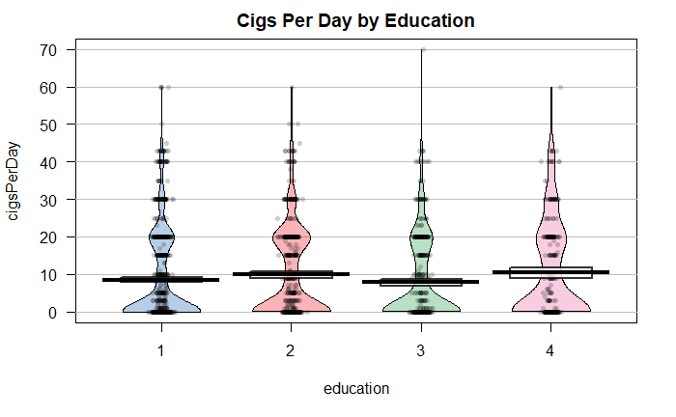
Notes:
1: Some high school
2: High school
3: Some college
4: College

Slide 9
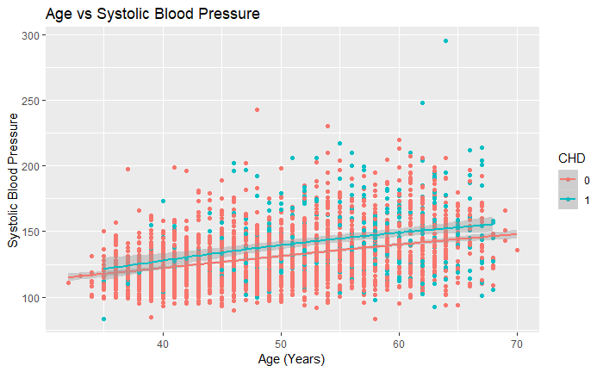

Slide 10
Logistic Model
Notes:
Johnny

Slide 11
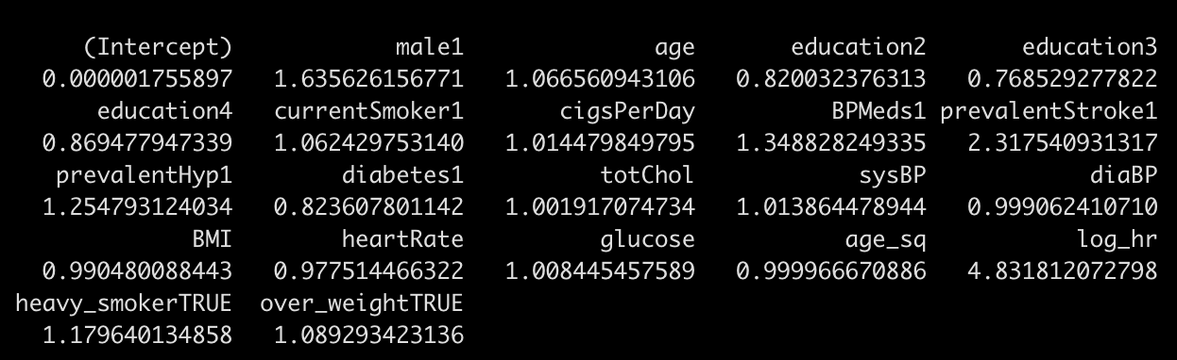
Coefficients
Male (63.5% more likely)
Prevalent Stroke (131.8% more likely)
Log Heart Rate (383.2% more likely)
Notes:
Johnny
Glucose was the one we were surprised about. It showed high significance and low odds ratio.

Slide 12
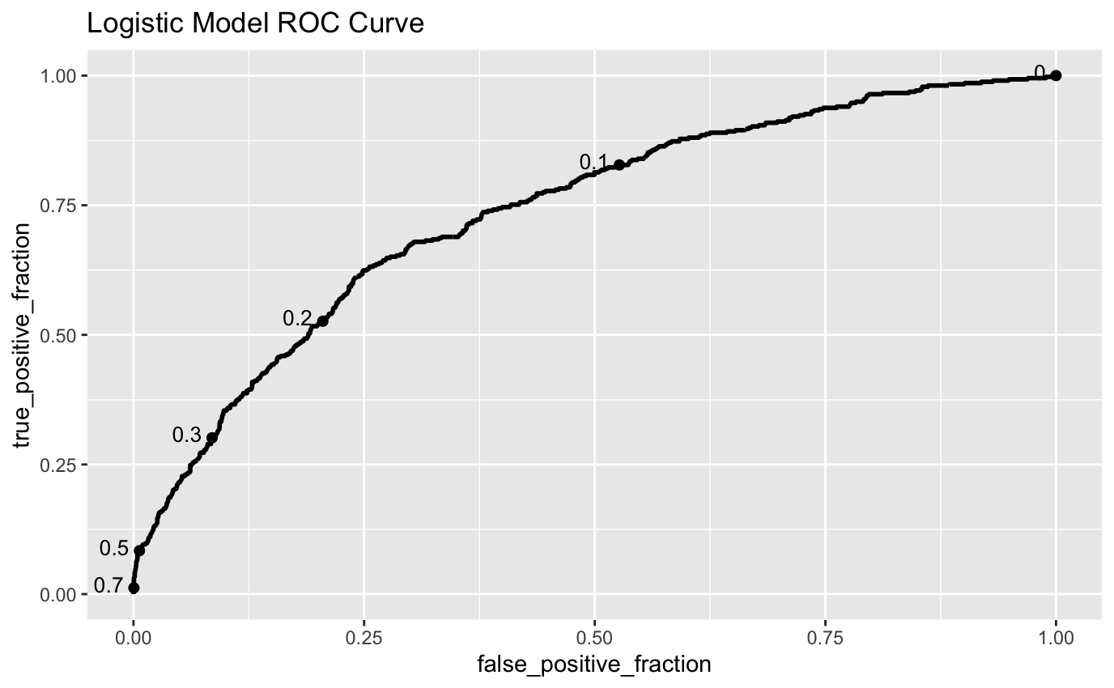
Logistic Model ROC and AUC
AUC: 0.74
Notes:
Johnny

Slide 13
Confusion Matrix
 |  | Predicted CHD Value (cutoff p>0.08)
 |  | No | Yes
True CHD Status | No | TN = 271 | FP = 504
 | Yes | FN = 8 | TP = 131
Notes:
Johnny
High false positive

Slide 14
Logistic Model Performance (cutoff probability of 0.08)
Accuracy: | 0.44
True Positive: | 131
True Negative: | 271
Sensitivity Rate: | 0.942
Specificity Rate: | 0.350
False Positive Rate: | 0.65
Notes:
Johnny

Slide 15


Random Forest Model
Notes:
Lai

Slide 16
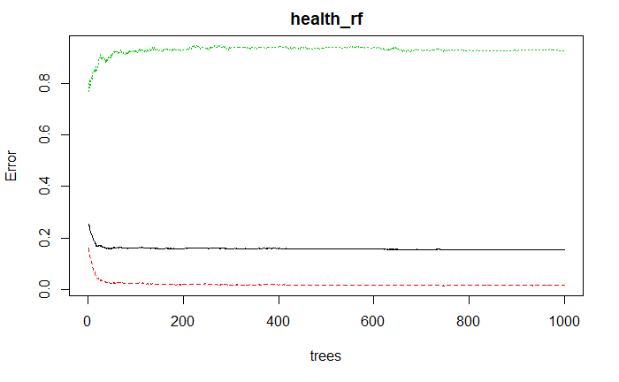
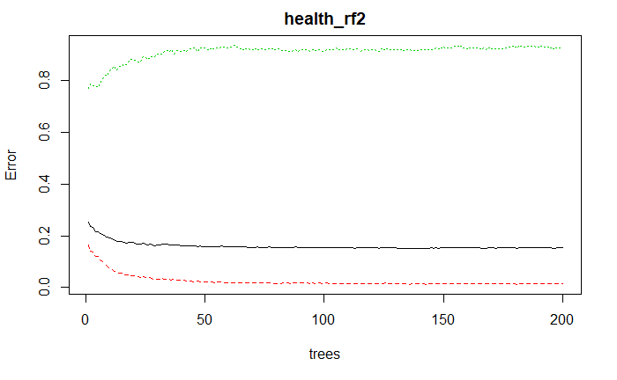
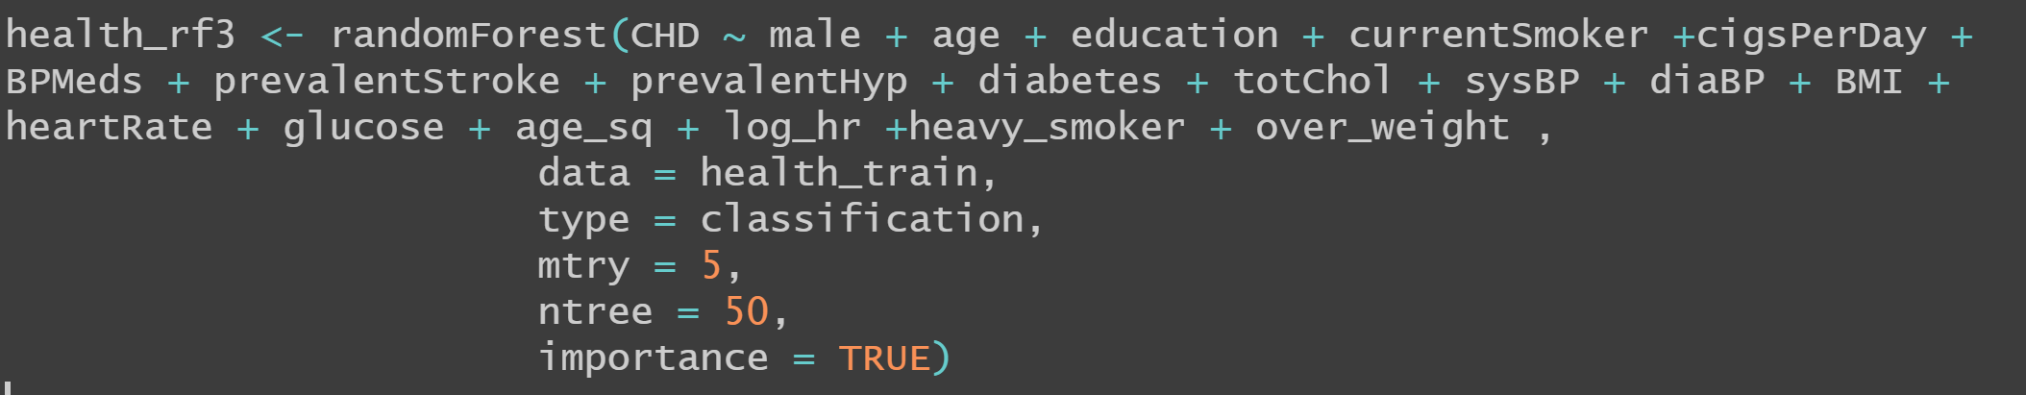
Determine # of Trees
Notes:
Lai

Slide 17
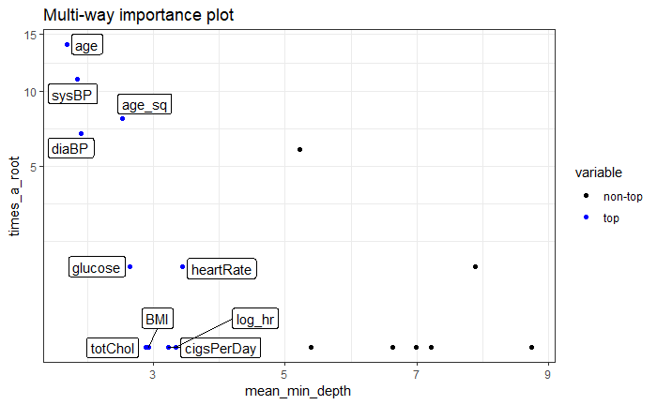
Notes:
Lai

Slide 18
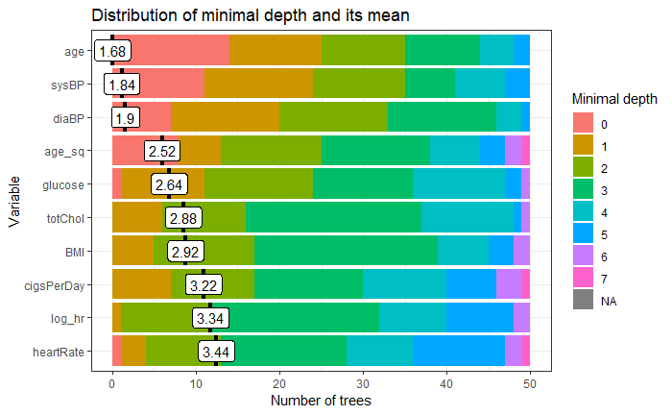
Notes:
Lai

Slide 19
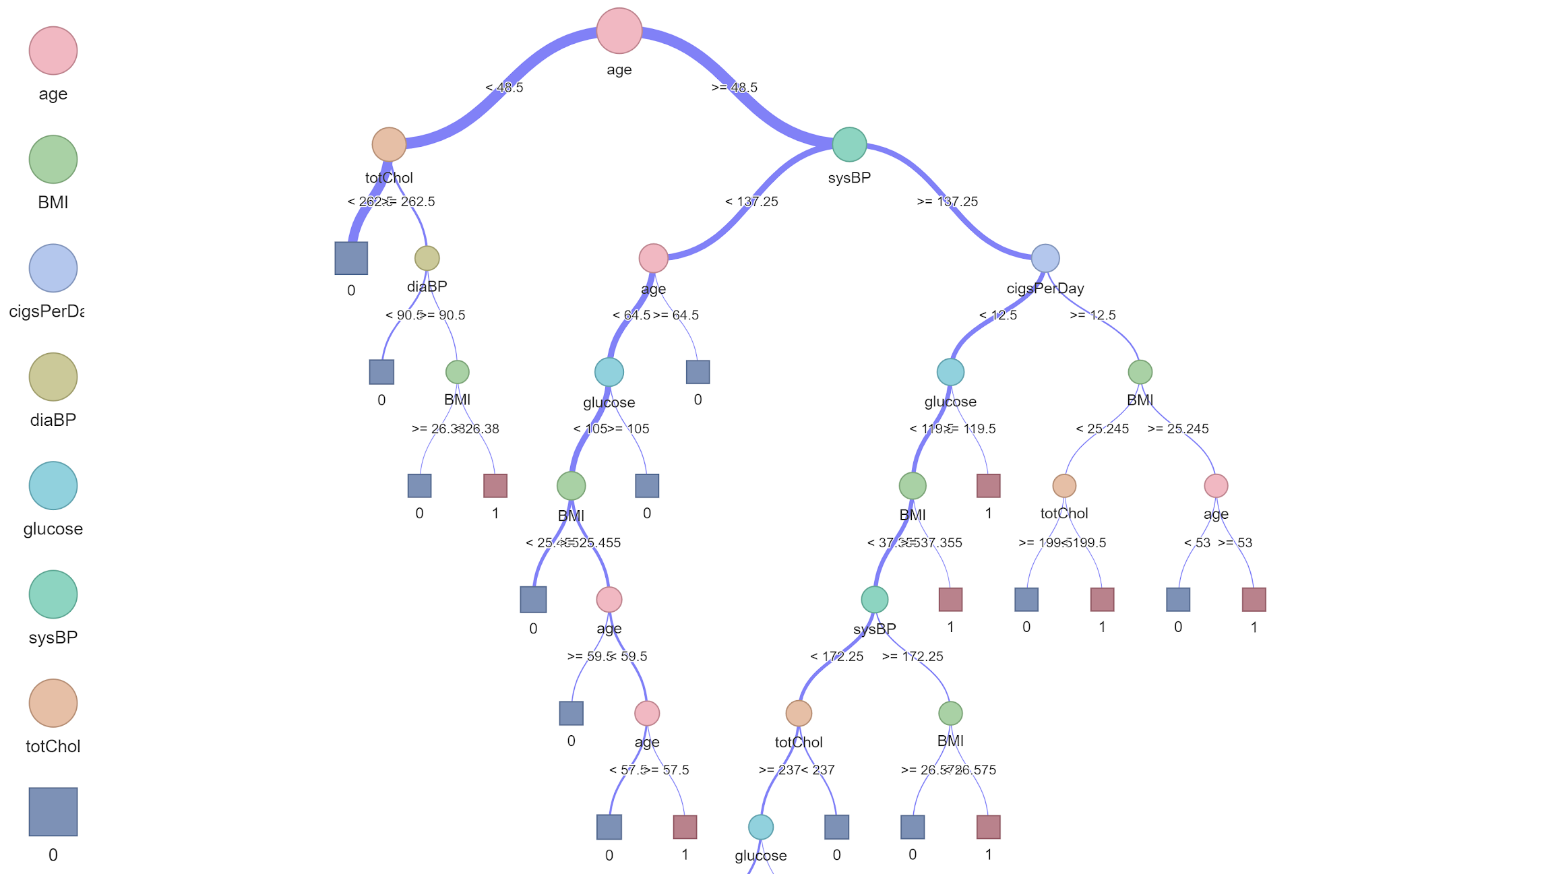
Example Tree
Notes:
Lai

Slide 20
Confusion Matrix
 |  | Predicted CHD Value (cutoff p>0.9)
 |  | No | Yes
True CHD Status | No | TN = 327 | FP = 448
 | Yes | FN = 23 | TP = 116
Notes:
Lai

Slide 21
Random Forest Model Performance (cutoff probability of 0.9)
Accuracy: | 0.485
True Positive: | 116
True Negative: | 327
Sensitivity Rate: | 0.835
Specificity Rate: | 0.422
False Positive Rate: | 0.578
Notes:
Lai

Slide 22

Lasso Model

Slide 23
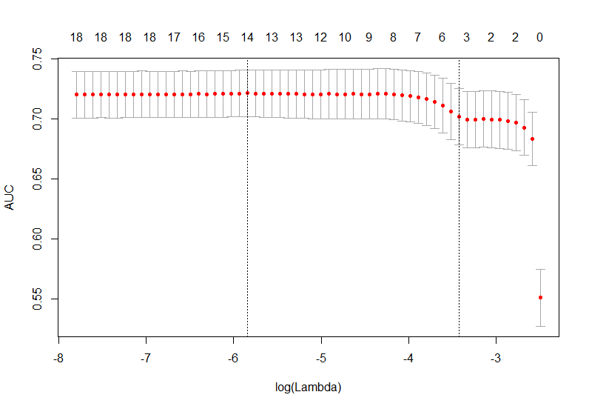
Coefficient Values (lambda 1se)
Variable | Coefficient
Intercept | -5.8262
Male | 0.0470
Age^2 | 0.0003
SysBP | 0.0096
Glucose | 0.0009
Notes:
conrad

Slide 24
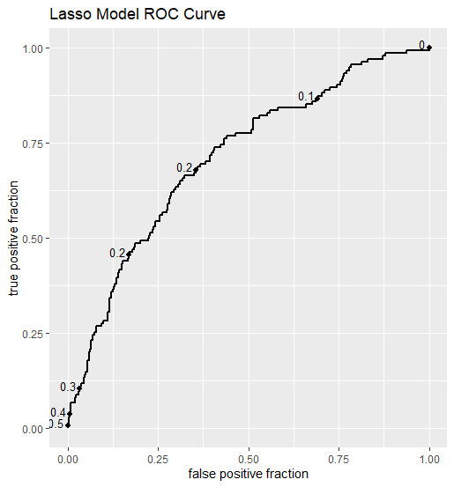
AUC: 0.71
Notes:
conrad

Slide 25
Confusion Matrix
 |  | Predicted CHD Value (cutoff p>0.1)
 |  | No | Yes
True CHD Status | No | TN = 153 | FP = 622
 | Yes | FN = 6 | TP = 133
Notes:
conrad

Slide 26
Lasso Model Performance (cutoff probability of 0.3)
Accuracy: | 0.313
True Positive: | 133
True Negative: | 153
Sensitivity Rate: | 0.957
Specificity Rate: | 0.197
False Positive Rate: | 0.803
Notes:
conrad

Slide 27
Elastic Net Model

Slide 28
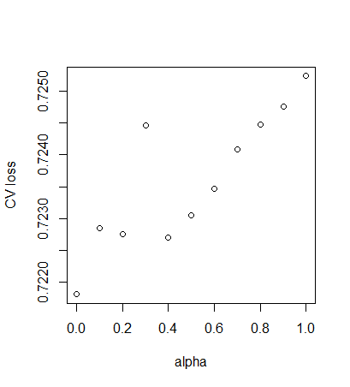
Notes:
Conrad
cv = cross valadation

Slide 29
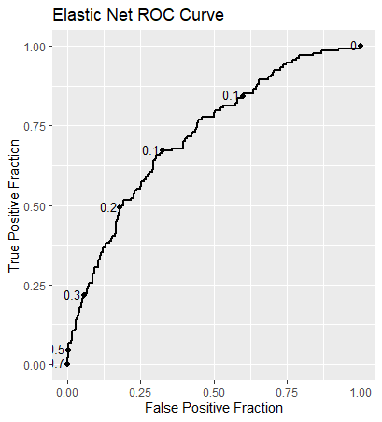
AUC: 0.72
Notes:
conrad

Slide 30
Confusion Matrix
 |  | Predicted CHD Value (cutoff p>0.1)
 |  | No | Yes
True CHD Status | No | TN = 273 | FP = 502
 | Yes | FN = 11 | TP = 128
Notes:
conrad

Slide 31
Elastic Net Model Performance (cutoff probability of 0.3)
Accuracy: | 0.439
True Positive: | 128
True Negative: | 276
Sensitivity Rate: | 0.921
Specificity Rate: | 0.352
False Positive Rate: | 0.648
Notes:
conrad

Slide 32

Best Model
 | Model | Sensitivity | Specificity
1 | Lasso | 0.967 | 0.197
2 | Elastic | 0.944 | 0.352
3 | Logistic | 0.924 | 0.350
4 | Random Forest | 0.835 | 0.422
Notes:
conrad

Slide 33

Questions or Comments?
*Slides and code are uploaded to github:
https://github.com/phamvlai/MGSC310_HeartDisease.git

